Slide 1
Applying for Financial Aid
Emily Culbertson, Associate Director of Financial Aid
Lenet Rivas, Senior Financial Aid Advisor
Office of Financial Aid
Oxford College of Emory University
Notes:
1

Slide 2
Who is Emory/Oxford
Emory College is a rigorous liberal arts experience in a research-university setting. Average class size is about 24
5,522 undergraduate enrollment
1,462 first- year class
Oxford College is the birth place of Emory and is a challenging, small liberal arts college experience in a close-knit campus of first- and second- year students. Average class size is about 20
979 total enrollment
537 first-year class
Academically equivalent, distinct by geographic locations

Slide 3
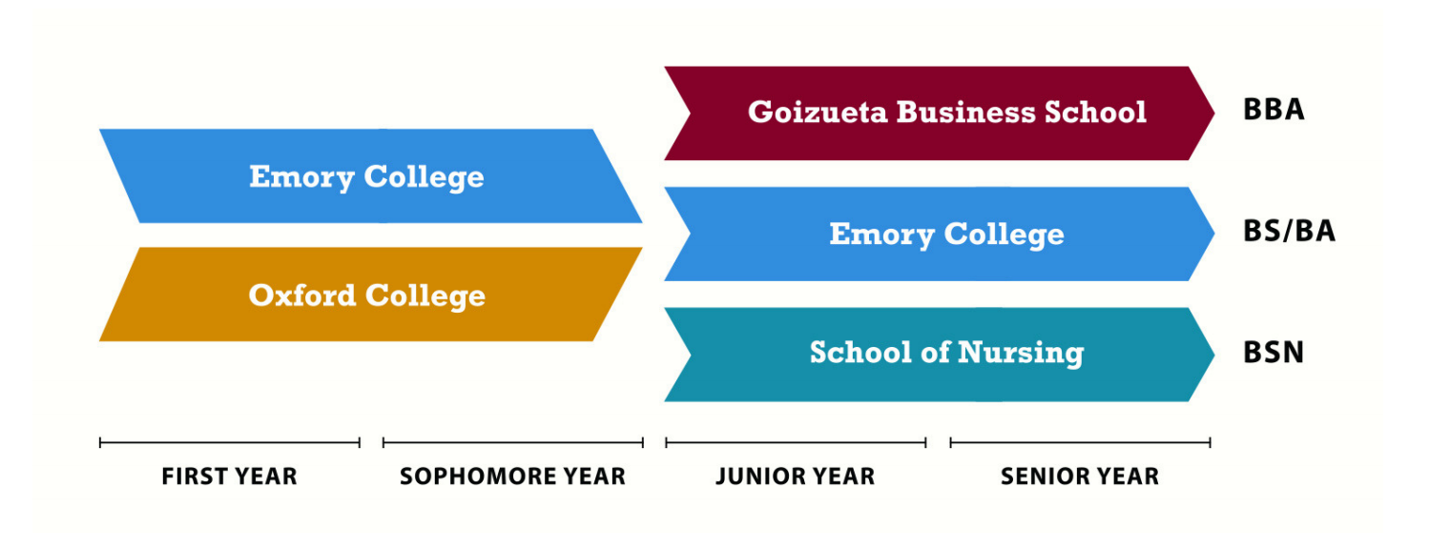
Emory/Oxford

Slide 4
Topics we will discuss tonight
What is financial aid?
Cost of attendance (COA)
Expected family contribution (EFC)
Financial need
Categories, types, and sources of financial aid
Free Application for Federal Student Aid (FAFSA)
CSS Profile
Special circumstances

Slide 5
Financial aid consists of funds provided to students and families to help pay for postsecondary educational expenses

Slide 6
What is Cost of Attendance (COA)?
Direct costs-
Tuition, fees, housing, food
Indirect costs-
Travel, books, personal
Students and families should prepare to pay for these out-of-pocket
Direct + Indirect costs = Cost of Attendance
Varies widely from college to college

Slide 7
What is Expected Family Contribution (EFC)?
Amount family can reasonably be expected to contribute
Families contribute to the extent that they're able, and have primary responsibility
The EFC derived from the FAFSA stays the same regardless of college
Two components:
Parent contribution
Student contribution
Calculated using data from a federal application form and a federal formula

Slide 8
What is Financial Need?
Cost of Attendance
– Expected Family Contribution
= Financial Need

Slide 9
Types of Financial Aid
Scholarships
Grants
Loans
Employment
Gifted Aid
Self Help Aid

Slide 10
Sources of Financial Aid
Federal government
Pell grants, federal work study, and federal loans
State
Hope and Zell Miller
Colleges and universities
Institutional grants and/or merit based
Private sources
Loans and/or external scholarships
Civic organizations and churches
Employers

Slide 11
Free Application for Federal Student Aid
Collects demographic and financial information​
Information used to calculate the expected family contribution (EFC)​
May be filed no earlier than the October 1st prior to the academic year to which the student requests aid
Check with your school for their specific guidelines and deadlines
For the 2019-2020 academic year, the FAFSA may be filed beginning October 1st, 2018
Most colleges set FAFSA filing deadlines

Slide 12
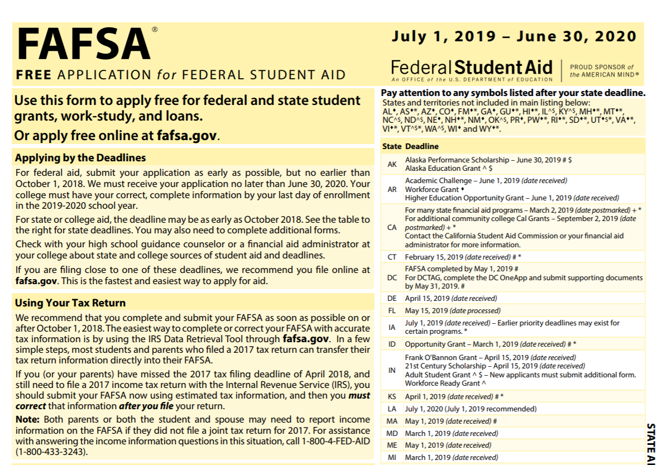

Slide 13
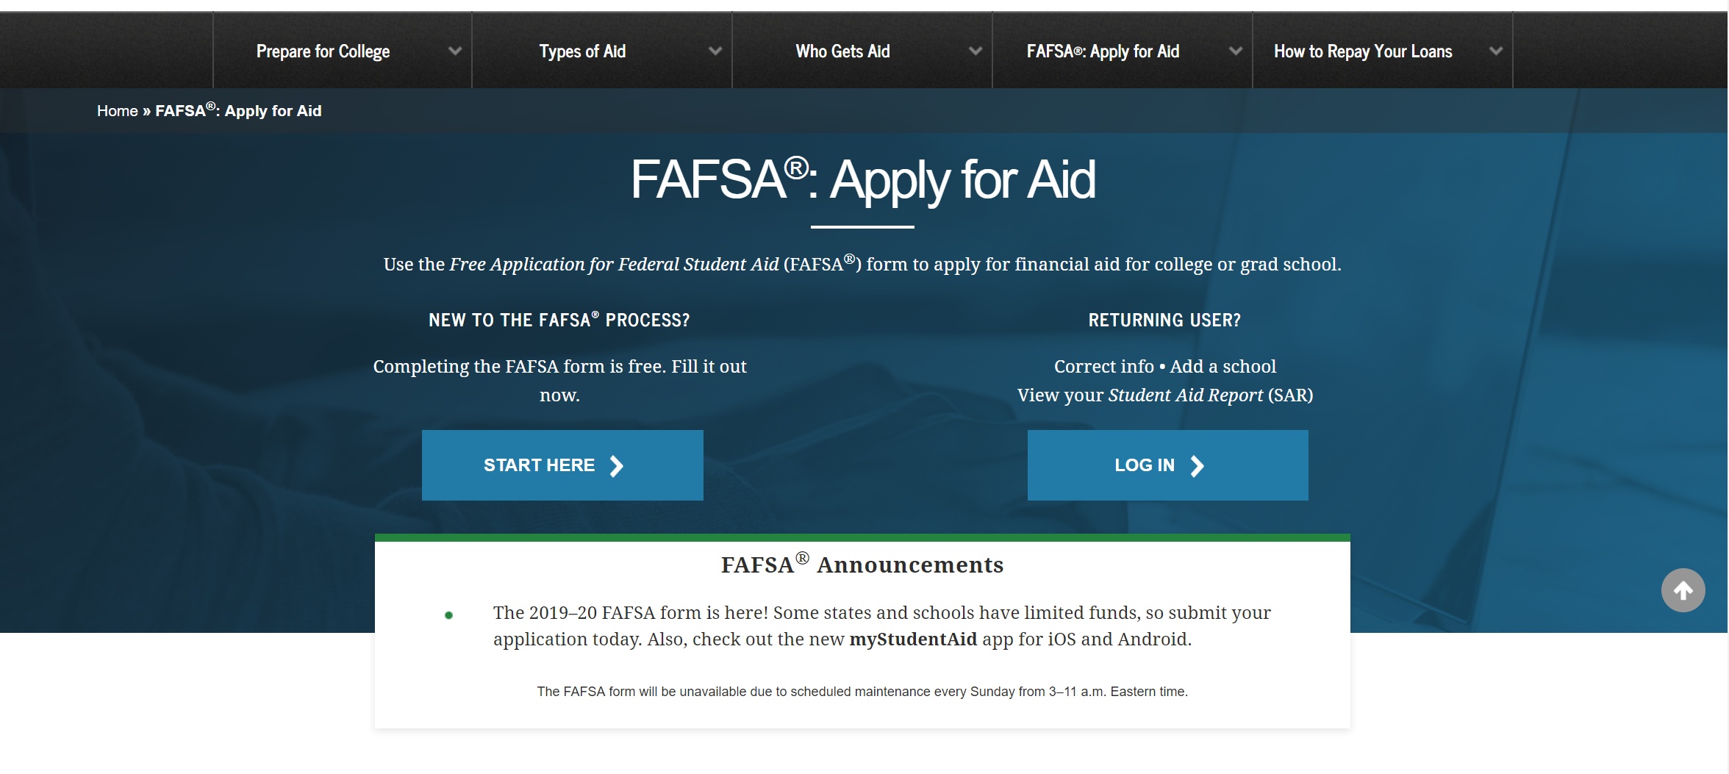
FAFSA on the web

Slide 14
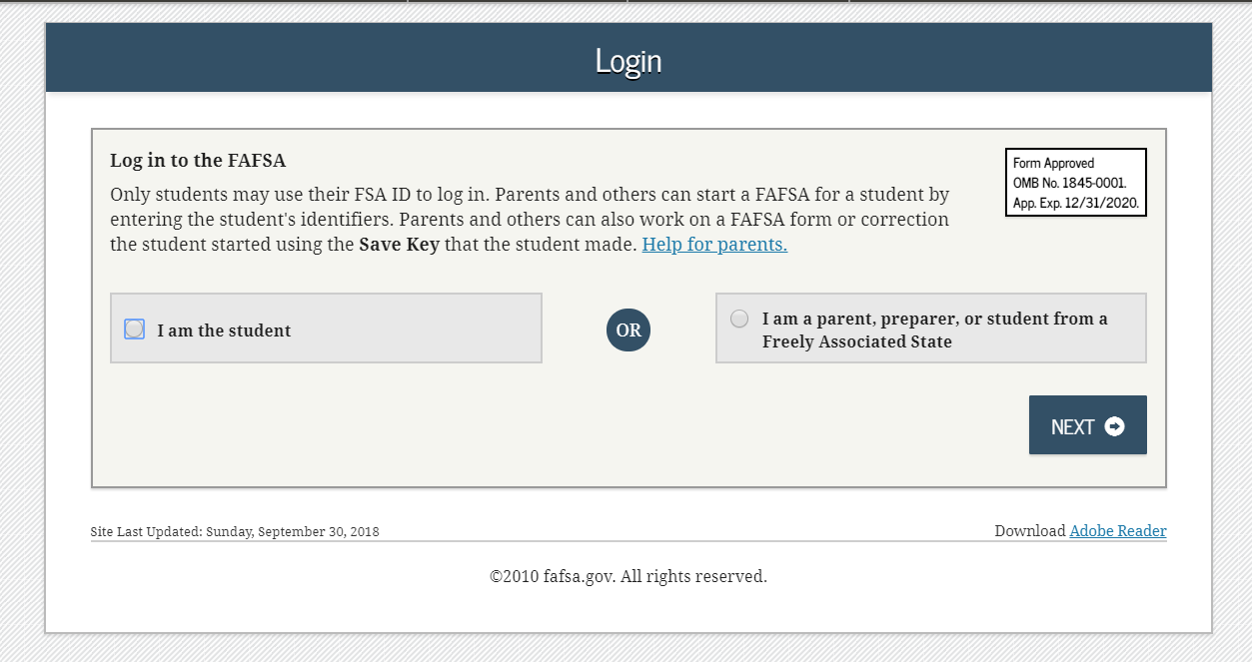
FAFSA on the web

Slide 15
myStudentAid Mobile App
Mobile ability to begin, complete, save, and submit the FAFSA
Information protected the same as FOTW​
Prompts applicant to create a save key, allowing completion at later time
FAFSA completion tracked​
Successful completion of each section indicated
Digital signature​
Confirmation of submission​
Estimated EFC calculation

Slide 16
IRS Data Retrieval Tool
Allows for certain tax return information to be transferred from the IRS database​
Participation is voluntary and student chooses whether or not to transfer data to FOTW​
IRS will authenticate taxpayer’s identity​
If tax record is found, IRS transfers information to populate the FAFSA​
Reduces errors and additional documents requested by financial aid office

Slide 17
IRS Data Retrieval Tool
Some will be unable to use the IRS DRT
Examples include:
Did not indicate on FAFSA a tax return was completed
Marriage date is January 2017, or later
First three digits of the SSN are 666
Filed a non-US tax return
Married and filed as head of household, or filed separate returns
Neither married parent entered a valid SSSN
Non-married parent or both married parents entered all zeroes for the SSN

Slide 18
General Student Information
Social Security Number
Citizenship Status
Marital Status
Drug Convictions
Selective Service registration
Level of parent’s school completion

Slide 19
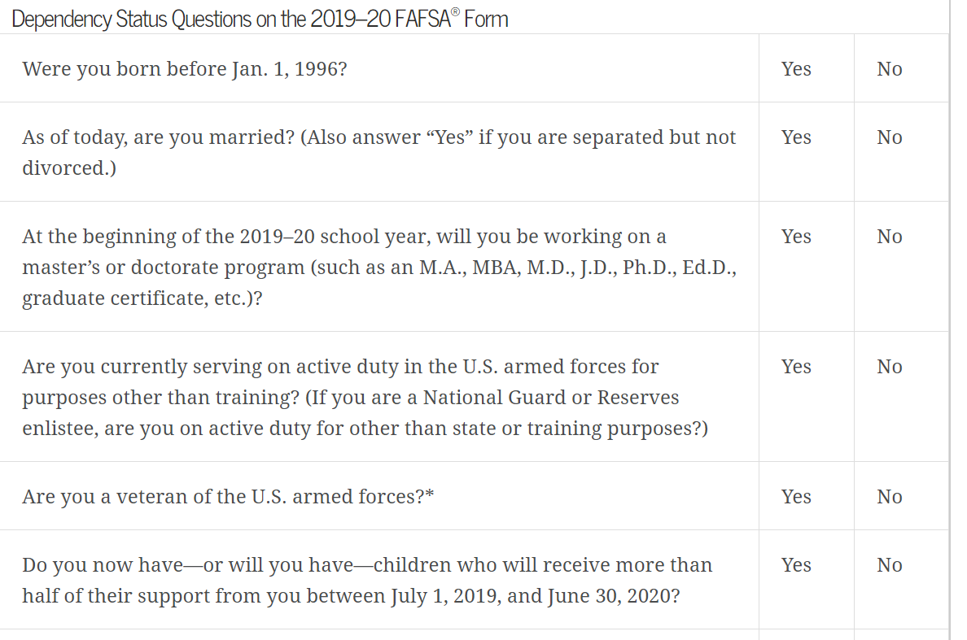
Student Dependency Status
FAFSA asks questions to determine dependency status for federal student aid (not IRS) purposes:
If all “no” responses, student is dependent
If “yes” to any question, student is independent
https://studentaid.ed.gov/sa/fafsa/filling-out/dependency

Slide 20
Frequent FAFSA Errors
Social Security Numbers- ensure it matches with the social on the admission application
If either parent does not have a social, enter all 0's
Divorced/remarried parental information
Income earned by parents/stepparents
Untaxed income
U.S. income taxes paid
Household size
Number of household members in college
Real estate and investment net worth- does not include retirement
Submitting a name that doesn't match a student's legal name
Forgetting to sign and submit

Slide 21
Applying to Private Colleges and Universities

Slide 22
Private Colleges and Universities
While the FAFSA is typically required by all colleges and universities, some schools may require additional applications to be completed
We recommend researching your top colleges and universities and identifying what is required from each school to determine aid eligibility
CollegeBoard- CSS Profile is commonly used among private colleges and universities to determine institutional need

Slide 23
What is the CSS Profile?
An online application for nonfederal student financial aid
Used by nearly 400 colleges, universities, professional schools, and scholarship programs to award more than $9 billion in grants
Check the College Board’s website for a list of schools and institutions that require the CSS Profile application
Available on October 1st of student's senior year
$25 fee for initial application and one college (or program report)
Additional reports at $16

Slide 24
Federal vs Institutional EFC
Completing the FAFSA will create a federal EFC
Similarly, completing the CSS will create an institutional EFC
It is possible that the two may not be the same; institutions may defer to the institutional EFC when awarding students with institutional aid

Slide 25
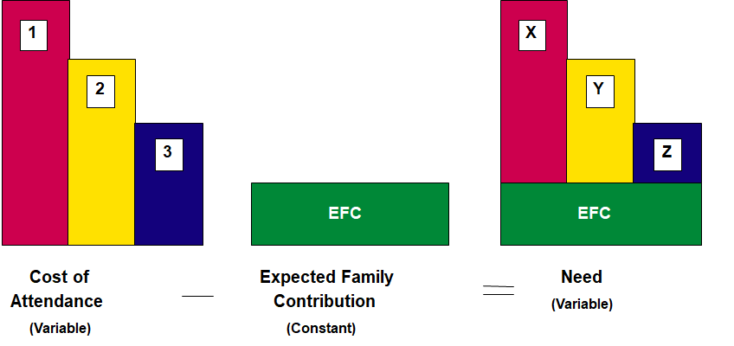
How financial need varies based on cost

Slide 26
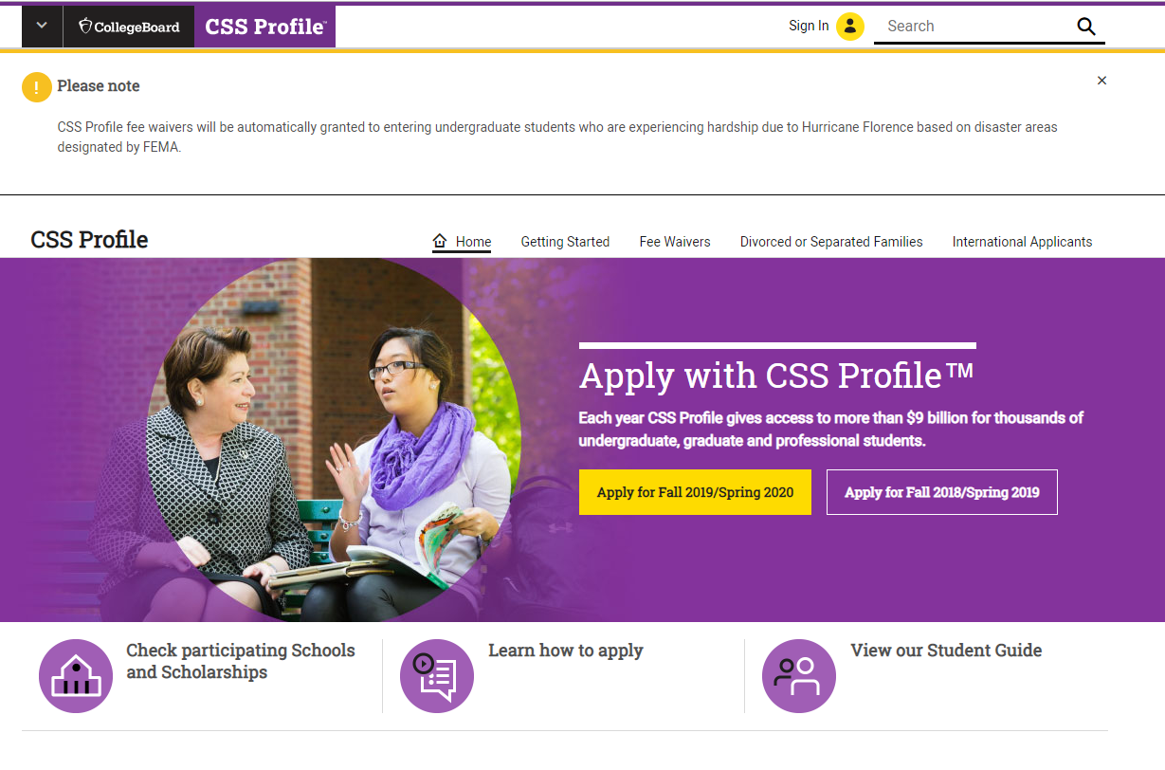
CSS Application

Slide 27
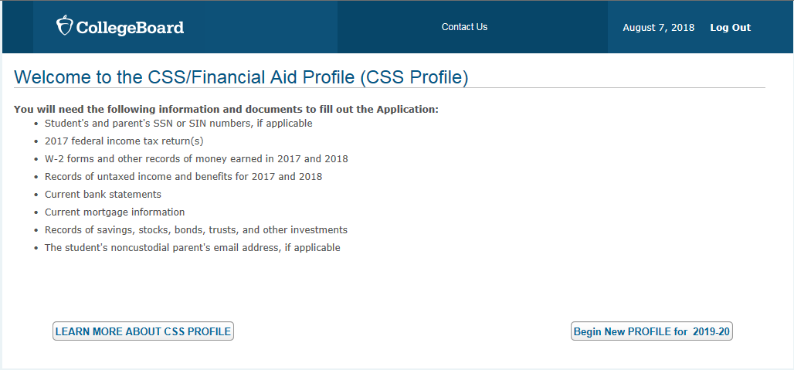

Slide 28
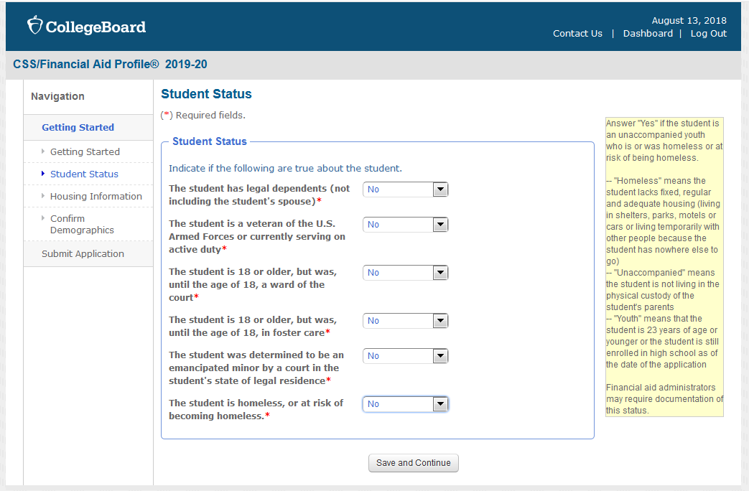

Slide 29
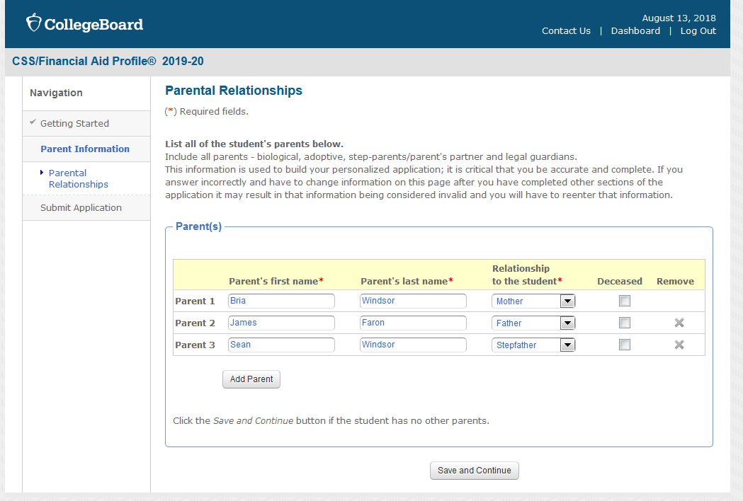

Slide 30
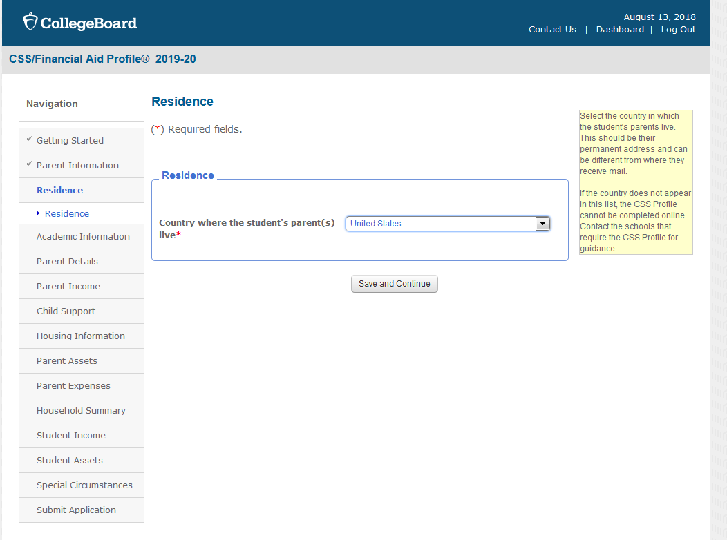

Slide 31
Divorced and Separated Parents
Noncustodial profile will be required when the marital status of the biological or adoptive parents is separated, divorced, or never married (FAFSA doesn't ask for NC information)
Waivers should be pursued where abuse, a restraining order, incarceration, or total disability, etc. exists
Documentation is necessary
Unwillingness is not a reason for a university to waive their requirement
Students need to be proactive and adhere to posted deadlines

Slide 32
IDOC
After completing the CSS application, you will be instructed to submit documents through the IDOC portal
Documents required may vary by school
It is important to have all documents submitted so that the school may start reviewing your file to create an award letter
IDOC will send out reminders about what forms are still missing and potentially reject some if they are incomplete

Slide 33
Sample Award Letter
COST OF ATTENDANCE- $34,000
BILLED COSTS OUT OF POCKET COST
TUITION $20,000 TRAVEL $1000
FEES $500 PERSONAL $1500
HOUSING $5,000 BOOKS $1000
FOOD $5,000
TOTAL DIRECT COST $30,500 TOTAL IN DIRECT COST $3500
$15,000
INSTITUTIONAL GRANT $13000
FEDERAL WORK STUDY $2500
FEDERAL SUBSIDIZED LOAN $3500
EXPECTED FAMILY CONTRIBUTION
FINANCIAL AID PACKAGE

Slide 34
What is Financial Need?
Cost of Attendance ($34,000- direct and indirect cost)
– Expected Family Contribution ($15,000)
= Financial Need= ($19,000- a combination of self help aid and institutional grant)

Slide 35
Myintuition
Myintuition.org

Slide 36
Special Circumstances
Cannot be documented using FAFSA
Send written explanation and documentation to financial aid office at each college (use college form where required)
College will review and request additional information if necessary
Decisions are generally final and cannot be appealed
Be mindful of college requirements for special circumstances- some have specific forms and deadlines that may be unique to that institution

Slide 37
Special Circumstances
Change in employment status
Unusual medical expenses not covered by insurance
Change in parent martial status
Unusual dependent care expenses
Student cannot obtain parental information

Slide 38
Additional Sources of Funding

Slide 39
Sources of Funding
Federal and institutional need based aid (does not have to be repaid)
Merit and State aid
External scholarships
Federal subsidized and unsubsidized loans offered to the student
$5500 for the first year; interest rates fluctuate every year
Parent PLUS Loan
Apply through FAFSA; interest rates fluctuate each year; awarded up to the COA
Private Loans
Can be borrowed by either the student or the parent
ROTC

Slide 40
Recap
Discuss what the family can reasonably and realistically afford to pay for college
Research the schools you are most interested in and make a spreadsheet with the required applications, deadlines, and COA
Even if the cost is out of reach, we always recommend applying because you may get a better package than expected
Become familiar with myIntuition
Always fill out the FAFSA
If you are a Georgia resident, you can either submit the FAFSA every year for Hope/Zell or apply through GAfutures.org
Fill out the CSS if required
Apply to as many external scholarships as possible

Slide 41
Questions

